Slide 1

Department of Computer Science and Engineering
Vessel detection from space borne images
Date: 13 May 2021
Nikitha Kambhampati - 17WH1A0507
Pagilla Sai Preethi - 17WH1A0547
Gaddam Nikitha - 18WH5A0502
Internal Guide : Ms. C Jagadeeswari Designation : Assistant Professor

Slide 2


Abstract
Why Should I Study this course?
Examples
BVRIT HYDERABAD College of Engineering for Women
Problem Statement:
This project aims at detecting large vessels (ships) in sea from satellite images.
Ship detection from remote sensing imagery is a crucial application for maritime security which includes traffic surveillance, protection against illegal fisheries, oil discharge control and sea pollution monitoring.
Project Objective:
To build an algorithm to automatically detect and segment ships in satellite images. Some of the challenging factors include flaws in image quality like uneven brightness, obstruction, many images which have similar shape, color and texture.
Another problem is that objects like islands, ports, whales etc look quite similar to ships. The algorithm had to be extremely accurate because lives and billions of dollars in energy infrastructure is at stake. In this algorithm custom MASK R CNN is used for predicting with more accuracy.

Slide 3
Architecture
Why Should I Study this course?
Examples
BVRIT HYDERABAD College of Engineering for Women
Data Acquisition
Data pre-processing and visualisation
Data augmentation
Building a deep learning model based on CNN
Evaluating model on training data
Data interpretation and visualisation

Slide 4
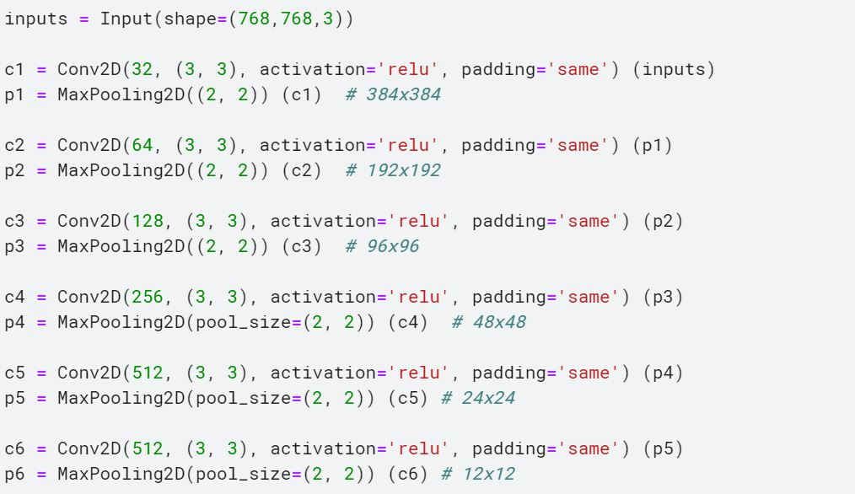
Model Code - Output

Slide 5
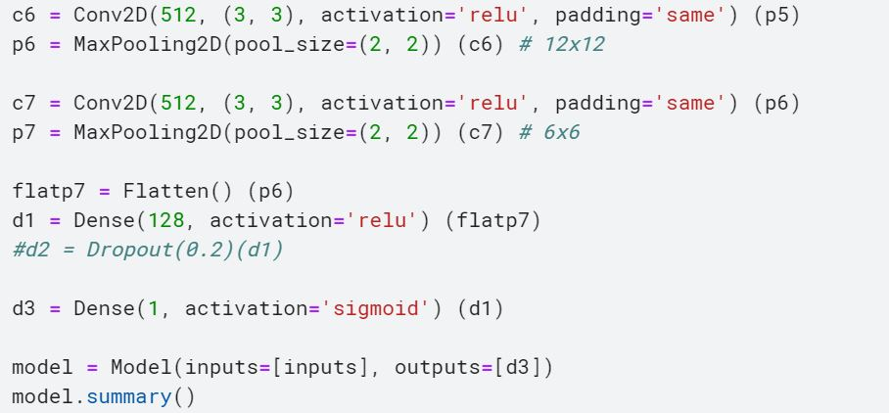

Slide 6
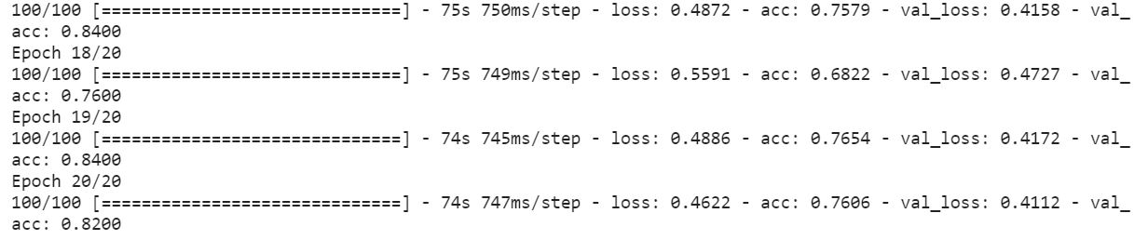

Slide 7
Thank you

